Slide 1
Spark SQL Bootcamp
December 2017

Slide 2

EIM and Analytics
Digital Engagement/Analytics
Customer Engagement Strategies
Omni-channel and Integrated Marketing
Strategic Planning, Building and Executing Digital and Customer Engagement Solutions.
Strategy and Competency Building
Build the right, comprehensive solution blueprint across 12 Domains
Establish, specific, actionable plan and ROIs
Protecting your investments
Organization, Talent, Competency
Processes, Methods, Techniques, Tools
Speed – Agile EIM Transformation
Governance processes
Data Science
Predictive and Prescriptive Analytics
Social, Text and Sentiment Analytics
Natural Language Processing
Machine Learning, Artificial Intelligence
SPSS, SAS, R, IBM Watson™
STRATEGY
DIGITAL
Traditional Data Warehouse and Business Intelligence
EDW, ODS, Data Mart and Integration
Master Data Management
Data Governance
Dashboards, Scorecards,
Reports , Alerts
Multidimensional Analysis
Ad hoc slicing and dicing
Self Service Enablement
Cloud Migration and Agile EIM
EIM and
ANALYTICS
400+ employees
strong
EDW&BI
DATA
SCIENCE
BIG DATA
Customer and Business Analytics
Customer/Buyer/Channel Segmentation
Persona Development, Customer Scoring (Value, Potential)
Attrition Modeling, Engagement and Response Modeling
Inventory Management, Marketing Campaigns
Product Design Analytics, Workforce Planning, Location Based Advertising
Data Monetization
ANALYTICS
Big Data and Next
Generation Technologies
Data Lab Development Centers
Data Lakes, Analytic Platforms
Hadoop (Cloudera, Hortonworks)
NoSQL / Graph DB (MongoDB, DataStax
Cloud platforms (AWS, Google, Azure)
Spark, Sqoop, Hive, Pig, Kafka, etc.
Notes:
Daugherty Business Solutions is a local alternative to the national consulting firms. Daugherty consultants live and work in their local communities. Daugherty has offices in St. Louis, Chicago, Atlanta, Minneapolis, Dallas, Denver, and New Jersey.
One of the lines of service for Daugherty is the Information Management. Within the Information Management Line of Service, there are six subdisciplines

Slide 3

Meet Adam Doyle
20 year veteran of the St. Louis IT community
Co-Organizer, St. Louis Hadoop User Group
Big Data Community Lead, Daugherty Business Solutions
Formerly Big Data Solution Architect at Amitech, Lead Big Data developer at Mercy
Speaker at local and national Big Data conferences
Notes:
Your instructor today is Adam Doyle. Adam is a 20 year veteran of the St. Louis IT community. His current position at Daugherty is Information Architect and Manager. He is also the Big Data Community Lead, focusing on capability development and strategy. Previously, Adam was a Big Data Solution Architect at Amitect Solutions, specializing in health care, and was the lead Big Data Developer at Mercy, a hospital system spanning five states in the southern Midwest.
In these roles, Adam has been a speaker at local and national conferences including Hadoop Summit, HDWA Annual Conference, and Stampedecon.
Adam is one of the organizers for the St. Louis Hadoop User Group, taking an active role in soliciting speakers, planning content, and hosting the events.

Slide 4
Introductions
What is your name?
What is your title?
What is the name of your company?
How deep is your experience with Python?
How deep is your experience with Spark?
Is your company planning on implementing an application with Spark in the coming year?

Slide 5
Agenda
Overview
Jupyter Notebook
Python Lambda
Spark SQL
Loading Data
Spark UI
Querying
Create Table
Data Federation
Working with generated tables
Pushdown
User Defined Functions
Spark Streaming
8:00 Start
9:00 Break
9:15 Resume
11:15 Lunch
12:15 Resume
1:30 Break
1:45 Resume
3:30 Finished
Notes:
Today will start with an overview of Spark to set the stage. We’ll spend some time discussing Spark SQL and working querying data from a relational database. Then we’ll work on loading data from a flat file and getting it to a query-able state. Then we’ll work on composite queries and optimizations. Finally we will finish by discussing Spark Streaming.

Slide 6
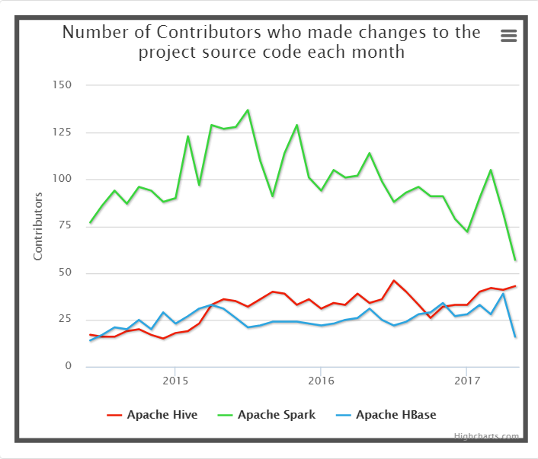
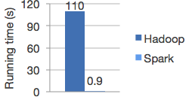
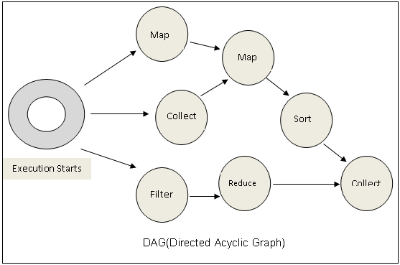
Why Spark in Pictures
https://www.sigmoid.com/apache-spark-internals/
Notes:
Before you take on a technology, it is important to understand where it comes from. Apache Spark was originally developed at Berkeley’s AMPLab in 2009. It was donated to the Apache Software foundation in 2013 and became a top-level project in 2014. It is among the most active projects in the Big Data ecosystem, with more committers than Apache Hive and Apache HBase. Why?
It originally started to get a lot of publicity when the developers were able to create a Logistic Regression model that performed over 100 better than a Hadoop MapReduce implementation of the same problem. There were a lot of factors that contributed to Spark’s success in this instance. For example, the scope of the problem fit into memory and Spark was able to cache the intermediate values in memory. But even when they expanded the scope of the problem so that the data couldn’t all fit into memory, Spark still beat MapReduce by a factor of 10. Why?
Part of the reason has to do with Spark’s use of Directed Acyclic Graphs, or DAGs. DAGs head in the same direction and they don’t loop back (acyclic). They are composed of collections of transformations and actions. The framework is able to figure out how to combine the transformations in the correct order in order to get the biggest return in such a way that it can minimize the number of operations that require a shuffle across of the nodes. Later implementations of MapReduce using the Tez execution engine use this same idea to get a large performance boost.
So speed was a definite factor in the beginning, but it has been the expansion of the Spark framework that has continued to attract developers.

Slide 7
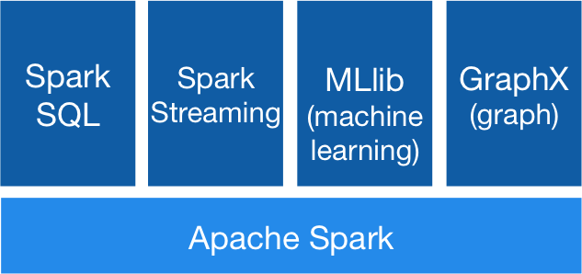
Components
Notes:
As released in 2009, Spark consisted of a batch processing layer now known as Spark Core. The closest analogy to Spark Core in the Hadoop ecosystem was MapReduce. So Spark Core was a more efficient version of MapReduce that was also easier to use. Developers for Apache Hive, a SQL Engine that uses MapReduce as its processing engine, looked at Spark as a way to increase the performance of Hive. The implementation of Hive on top of Spark was called Shark. At some point, the Spark developers realized that they didn’t need Hive and they developed a SQL Processing module for Spark. That was the beginning of Spark SQL.
One of the biggest problems that early Big Data solutions needed to solve was handling streaming data. Flume was used to load log data into Hadoop, but it couldn’t make the downstream systems ingest it any faster. Apache Storm and Apache Samza both handled the stream of messages one message at a time. This works, but it becomes difficult to handle state at this fine of a detail. Also, both Spark and Samza are low-level APIs and required developers to handle all aspects of the handling of the message. The Spark community went a different way. They preferred to handle the infinite stream of data as a series of small batches, or micro-batches. They were able to leverage the existing batch processing framework and with some additions Spark Streaming was born.
The developers for Apache Mahout, a machine learning library for Hadoop, were concerned with some of the gaps in the MapReduce processing framework. In particular, it was impossible to persist an intermediate state. They started looking at the Spark framework to address these gaps and to provide the speed increase of Spark Core over MapReduce. That was the beginning of Spark MLLib. Now, Mahout is considered a mostly dead project and most of the new work is being done in MLLib. Finally, Spark implemented a module to assist with Graph calculations that are so important for major dotcoms like Facebook and LinkedIn.
We will cover Spark Core lightly, Spark SQL is great detail, and Spark Streaming lightly, but we’ll only cover the general details behind Spark MLLib and GraphX.

Slide 8
Spark Versions
Spark Version | Features
1.5 | Spark Core, Spark Streaming, Spark SQL, DataFrame, Spark MLLib, GraphX (new), Bagel (older graph processing), Spark R
1.6 | SQL queries on files, DataSet, Spark MLLib pipelines, Bagel retired
2.0 | United DataFrame and DataSet, Replace HiveContext with SparkSession, Native SQL parser, Structured Streaming
2.1 | Scalable Partition Handling, Observed delay for Event time Watermarks, Locality sensitive hashing
2.2 | Cost-based optimizer, Structured Streaming GA, enhancements for Apache Kafka
Notes:
Spark has a number of versions that are still in use. Version 1.6 is the lowest version that is still supported and deployed. The central difference between version 1.6 and version 2.0 is the DataSet API. More recent versions of Spark have pushed more towards using the DataSet API over the RDD and DataFrame implementations.

Slide 9



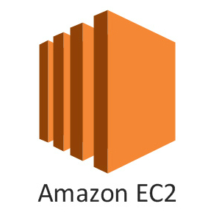
Infrastructure
When deploying Spark for use, you have a couple of options
Notes:
When deploying Spark, you have a couple of options. You can deploy Spark on a Hadoop cluster, on a Mesosphere cluster, on Amazon EC2, or as a standalone application.

Slide 10
Language
Scala
Java
Python
val lines = sc.textFile("data.txt")
val lineLengths = lines.map(s => s.length)
val totalLength = lineLengths.reduce((a, b) => a + b)
JavaRDD<String> lines = sc.textFile("data.txt");
JavaRDD<Integer> lineLengths = lines.map(s -> s.length());
int totalLength = lineLengths.reduce((a, b) -> a + b);
lines = sc.textFile("data.txt")
lineLengths = lines.map(lambda s: len(s))
totalLength = lineLengths.reduce(lambda a, b: a + b)
Notes:
As noted previously, Spark is a framework where the developer takes care of implementing the business logic and application flow. There are three primary languages that are supported for application development – Scala, Java, and Python. Spark is natively developed in Scala, so features are generally first made available to Scala. Scala can be developed in both a functional programming mode and an object oriented mode. These considerations make Scala the first choice for Spark development.
Scala is a JVM language which means that features developed in Scala have a short port timeframe to be made available in Java. Features are generally quickly ported from Scala to Java. With the development of lambda functions in Java 8, Java better supports functional concepts, but it is still primarily an object oriented language. One of the concerns with Java is that objects must be Serializable, which means that some Scala objects are not immediately available for use in Java. Java is a good choice for a Spark development language, but not a first choice.
Python is a language that is popular among data scientists and developers because its well-developed numerical, scientific, and machine learning capabilities. It also requires much less code to develop a functional application. When Spark embraced Python as a first class language in which to develop, it enabled Python developers to perform Big Data analytics from ETL to visualization using their preferred language.

Slide 11
Resilient Distributed Data Sets
Resilient, i.e. fault-tolerant with the help of RDD lineage graph and so able to recompute missing or damaged partitions due to node failures.
Distributed with data residing on multiple nodes in a cluster.
Dataset is a collection of partitioned data with primitive values or values of values, e.g. tuples or other objects (that represent records of the data you work with).
In-Memory, i.e. data inside RDD is stored in memory as much (size) and long (time) as possible.
Immutable or Read-Only, i.e. it does not change once created and can only be transformed using transformations to new RDDs.
Lazy evaluated, i.e. the data inside RDD is not available or transformed until an action is executed that triggers the execution.
Typed — RDD records have types, e.g. Long in RDD[Long] or (Int, String) in RDD[(Int, String)].
Cacheable, i.e. you can hold all the data in a persistent "storage" like memory (default and the most preferred) or disk (the least preferred due to access speed).
Parallel, i.e. process data in parallel.
Partitioned — records are partitioned (split into logical partitions) and distributed across nodes in a cluster.
Location-Stickiness — RDD can define placement preferences to compute partitions (as close to the records as possible).
Notes:
The original Spark data structure is the resilient distributed dataset, or RDD. It is still the underlying data structure at the root of the DataFrame and DataSet implementations. A RDD consists of the pointer to the data and the transformations operations that have been programmed to work on the data. When an action is invoked against the RDD, the data is loaded and the transformations are applied. If the machine on which the data was loaded goes down, the data can be loaded onto a different machine and the process reinvoked.

Slide 12
RDD vs. DataFrame vs. DataSet
Feature | RDD | DataFrame | Dataset
Low-level | Y | N | N
Functional Programming | Y | N | Y
Type-safe | Y | N | Y
Relational | N | Y | Y
Catalyst query optimization | N | Y | Y
Tungsten direct/packed RAM | N | Y | Y
JIT code generation | N | Y | Y
Sorting/shuffling without deserialization | N | Y | Y
 | HOW to do | WHAT to do | WHAT to do
Notes:
RDDs are the lowest level abstraction that Spark provides. It is type-safe and allows for functional programming concepts. Under the covers of all of the other data abstractions are implemented on top of the RDD. This means however that the Dataframe and Dataset abstractions provide additional functionality. The Dataframe abstraction provides relational concepts as well as the Catalyst and Tungsten optimizations. The one area where a dataframe is lacking is in terms of type safety and access to functional programming concepts. The Dataset abstraction has all of the attributes of the Dataframe and the type-safety and functional programming aspects of the RDD.

Slide 13
Spark Development
Transformations
Actions
T:filter
T:map
T:flatMap
A:collect
T:map
A:save
Notes:
When developing an application the user is responsible for creating the application flow and implementing the business logic. For this application, the developer would set up the flow of filter, map, flatmap, collect, map and save. The developer would then create the implementation of each of these functions – which items to filter out and how to map the data into another form. The implementations of save and collect are handled by the framework. During the running of the application, the RDD acquires the filter, map, and flatMap logic, but only evaluates them once the collect is called. The resulting RDD acquires the subsequent map operation which is invoked when the save is called.

Slide 14
Architecture
Jupyter
Python
Spark
Notes:
Before we begin, let’s talk about the application architecture. As a user, you will be logging into the Jupyter application. The Jupyter application is a notebook that allows you to create applications using Python. These applications will be run using the Python executable, but in some cases, the code will encode a Spark process that will be run on the Spark framework.

Slide 15
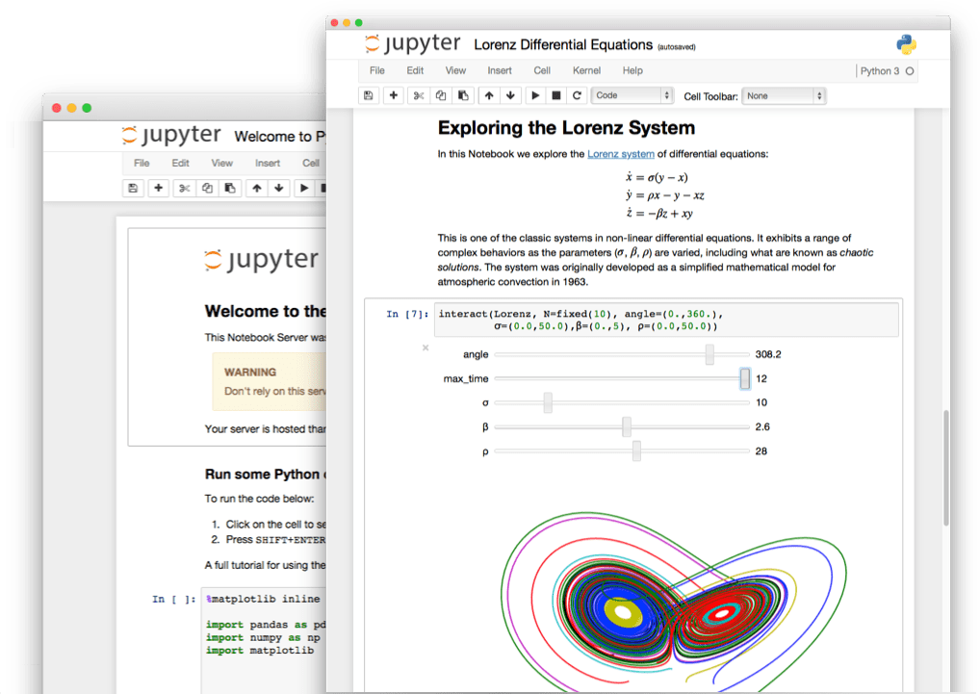
Jupyter Notebook
Jupyter Notebook is the successor to the iPython notebook.
It is a web application that allows for users to create and share documents that contain live code, equations, visualizations and explanatory text.
Notes:
Jupyter Notebook is a web application that allows for the user to create and share documents that contain live code, equations, visualizations, and explanatory text. There are three types of cells: code, markdown, and raw. Code cells are evaluated using the selected kernel or evaluation engine. Markdown is docu that may contain particular for

Slide 16
Structure of a Jupyter Notebook
Markdown cells
Raw cells
Code cells
Notes:
Changing the type of cell is a matter of selecting a cell, then navigating to the Cell menu and selecting the Cell Type drop down. You can select Markdown, Raw NBConvert or Code. By default all cells are code cells.
Markdown cells use the Markdown markup language that is a superset of HTML. See the specification:
https://daringfireball.net/projects/markdown/
Using Markdown characters will cause the text to be formatted differently.
Raw cells provide a place where you can write output directly. There is a tool called nbconvert that apply additional formatting to the raw cells.
Code cells allow you to edit and write new code. By default, the code cells understand Python, but the notebook can be configured to handle other languages like Julia and R. The result is generally text, but can be other data types when the calling libraries will produce those other types.

Slide 17
Exercise 1: Connecting to the Jupyter Notebook
Using your browser, navigate to the provided website.
Click on the Exercise1.ipynb
Follow the prompts to count the rows in the User table
Notes:
In this class all of the exercises will be given in the form of Jupyter notebooks. There will be some explanation given in the markdown cells in terms of what is expected to be implemented in the code cells. In the solutions directory there will be a Jupyter notebook for each that contains a solution. Please refer to these notebooks only when you are stuck.
In this exercise, the goal is to connect to the Jupyter server and execute the code in the Notebook.

Slide 18
Python Data Science libraries
SciPy
NumPy
Scikit-learn
Pandas
NLTK
Notes:
There are a number of libraries in Python that are popular with data scientists
Scipy – handles linear algebra operations
Numpy - array creation and operations
Scikit-learn – machine learning algorithms
Pandas – working with relational or labelled data structures
NLTK – natural language toolkit
It is important to consider the size of your data if you are trying to use Python for your data science analysis. These algorithms may work with a sample of your overall data, but it may run into size concerns when attempting to run at scale.

Slide 19
Python lambda function
The lambda operator is a way to create small anonymous functions designed to be thrown away.
Func = lambda x, y : x + y
Func(2,3)
5
Combine with Map
Out = map(func, [[2,3], [4,5], [6,7]])
[5, 9, 13]
Combined with Filter
DivisibleBy3 = lambda x: x % 3 == 0
Out = filter(DivisibleBy3, [0,1,2,3,4,5,6,7,8,9])
[0,3,6,9]
Combine with Reduce
Sum = reduce(Func, [1,2,3,4,5,6,7,8,9])
45
Notes:
The Lambda function came to Python for the Lisp programmers who were looking for functional programming constructs. Spark is also looking to use functional programming constructs.
The syntax for the lambda function is simple. After the lambda keyword, the input variables are declared. The colon divides the declaration from the implementation. Being a Python function, it returns the last value in the line as its return value. All of the displayed lambda functions are single-line functions, but your lambda function does not have to be.
Combining the lambda function with the map operation is used to transform your data. The function is applied to each element of the input. The function may choose not to return a value or it may return multiple values. As long as the returned values are of a consistent type, the function works correctly. Examples of map operations include: transforming your data from one type to another, applying date logic, removing unneeded columns, and pivoting your data.
Combining the lambda function with the filter operation is used to filter your data by some custom criteria. The function must evaluate to a Boolean - true or false. The function will always return a value. Examples of filter operations include: removing invalid records, forking the data to different processes, and segmenting the data for a given run.
Combining the lambda function with the reduce operation is used to combine all of your records into a single value. The function takes two parameters and combines them into a single parameter. Example of reduce operations include: summing numerical values, combining data items into collections, and consolidating sets of data.

Slide 20
Exercise 2: Create Python Lambda Expression
From the Jupyter notebook home, Click on the Exercise2.ipynb
Follow the prompts to filter the rows with null and empty values for the name field and transform the data using a map function.
Notes:
The goal of this exercise is to work with the python lambda expression to filter and transform your data.

Slide 21
Spark SQL
1
2
3
Spark SQL is the Monty Hall problem of Spark.
The extra information about the data – its schema, its storage, its use – allow Spark to optimize the ways in which it handles the data.
Notes:
The Monty Hall problem is named for its similarity to the Let's Make a Deal television game show hosted by Monty Hall. The problem is stated as follows. Assume that a room is equipped with three doors. Behind two are goats, and behind the third is a shiny new car. You are asked to pick a door, and will win whatever is behind it. Let's say you pick door 1. Before the door is opened, however, someone who knows what's behind the doors (Monty Hall) opens one of the other two doors, revealing a goat, and asks you if you wish to change your selection to the third door (i.e., the door which neither you picked nor he opened). The Monty Hall problem is deciding whether you do.
The correct answer is that you do want to switch. If you do not switch, you have the expected 1/3 chance of winning the car, since no matter whether you initially picked the correct door, Monty will show you a door with a goat. But after Monty has eliminated one of the doors for you, you obviously do not improve your chances of winning to better than 1/3 by sticking with your original choice. If you now switch doors, however, there is a 2/3 chance you will win the car (counterintuitive though it seems).
Spark SQL operates in a similar way. At its heart, a Spark SQL application is a Spark application. The data will be stored in RDDs. A series of transformation and actions will be applied to the data. However, because Spark SQL has extra information – in this case about the schema of the data, the underlying storage mechanism or file format of the data, or how it is being used – Spark SQL can make certain optimizations in order to more efficiently process the data. It isn’t a 2x improvement in processing time, but it is more efficient in terms of processor usage and memory.

Slide 22
Getting started
from pyspark.sql import SparkSession
spark = SparkSession \
.builder \
.appName("Python Spark SQL basic example") \
.config("spark.some.config.option", "some-value") \
.getOrCreate()
Notes:
Before we can start working with Spark, we need to initialize it in the Jupyter notebook. The lines entered on the screen initialize Spark SQL and get it ready to do some processing.
To get Spark Core ready to do some processing, the command is:
from pyspark import SparkContext sc = SparkContext()
Only one SparkContext can be active at a time, so keep in mind if you have already initialized your context.
For information on how to get the EC2 instance set-up see the appendix.
We set up two RDS servers, one with MySQL 5.6.35 and the other with Postgres 9.6.2.

Slide 23
Load a Table from a Database into a Data Frame
dataframe_mysql = mySqlContext.read.format("jdbc").options( url="jdbc:DRIVER_TYPE://SERVER:PORT/DATABASE” \
, driver = “JDBC_DRIVER_CLASS“ \
, dbtable = “TABLE_NAME“ \
, user=“USER_NAME“ \
, password=“PASSWORD").load()
Notes:
The format for the JDBC access derives from the JDBC database access configuration. The driver type and JDBC driver changes based on the type of database that is used.
Database Driver Type JDBC Driver
MySQL mysql com.mysql.jdbc.Driver
Postgress postgresql org.postgresql.Driver
Oracle oracle:thin oracle.jdbc.OracleDriver
SQL Server sqlserver com.microsoft.sqlserver.jdbc.SQLServerDriver
The user, password, server and port are configured to the settings for your database. The database name is configured based on the database to which you want to connect. The table name is specific to the table that you wish to load into the data frame.
The final command in the sequence is load(), which adds to the command to lazily load the data from the Data Frame Reader into a data frame onto the underlying RDD. It isn’t until an action is executed that the command is evaluated.

Slide 24
Exercise 3: Load Data from MySQL
Go to the home directory for Jupyter.
Open up Exercise3.ipynb and complete the exercises.
Record the port number that the last section returns to you.
Notes:
The goal of this exercise is to load data from a remote MySQL database. The secondary goal of this operation is to determine which port your application is using. We will use the port in the next section as we investigate the Spark UI.

Slide 25
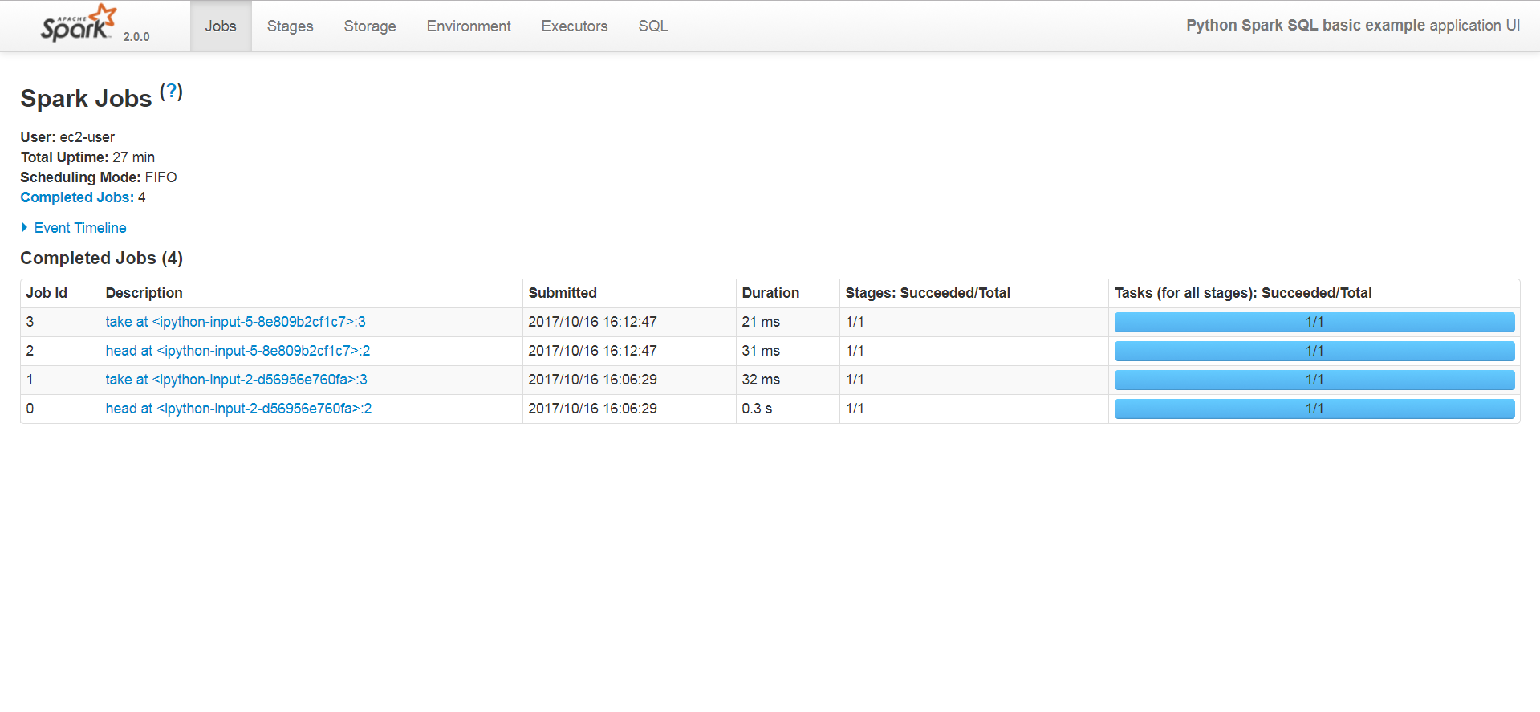
Spark UI - Jobs
Notes:
Each new context is given its own instance of the Spark UI. You can access it by navigating to the Spark server and selecting a your port. The ports start at 4040 and increment by 1 for each new application on the server. An example URL would be
http://spark.server:4040
And so the next in the sequence would be
http://spark.server:4041
Use the port number returned in Exercise 3. When you get to the Spark UI, you are presented with a series of tabs – Jobs, Stages, Storage, Environment, Executors, and SQL. By selecting a tab, you can view its information. The other important pieces of information are the version of Spark you are using and the name of your application.
On the jobs tab, you can view the jobs that your application has attempted. If there were any errors, there would be a difference between the jobs that succeeded and the total number of jobs. Click on the job information takes you to the job detail screen.

Slide 26
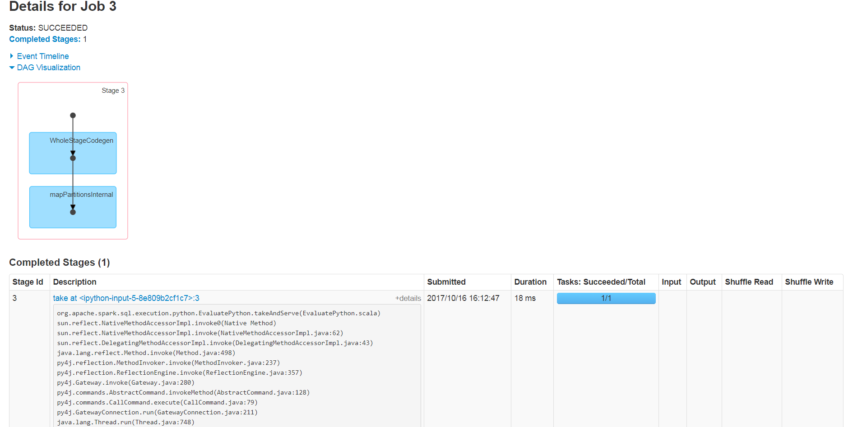
Spark UI – Job Detail
Notes:
The job detail screen can offer information about a particular job in the sequence of jobs that made up a particular execution. This is useful when needing to debug job failures. Additionally there are options to view the event timeline, the DAG visualization (shown), and to see more details behind the implementation of a particular job. The stack trace looks like Java code for a good reason. All of the Spark-centric operations are still implemented in Java. Drilling into the particular stage will transition to the Stage Detail tab.

Slide 27
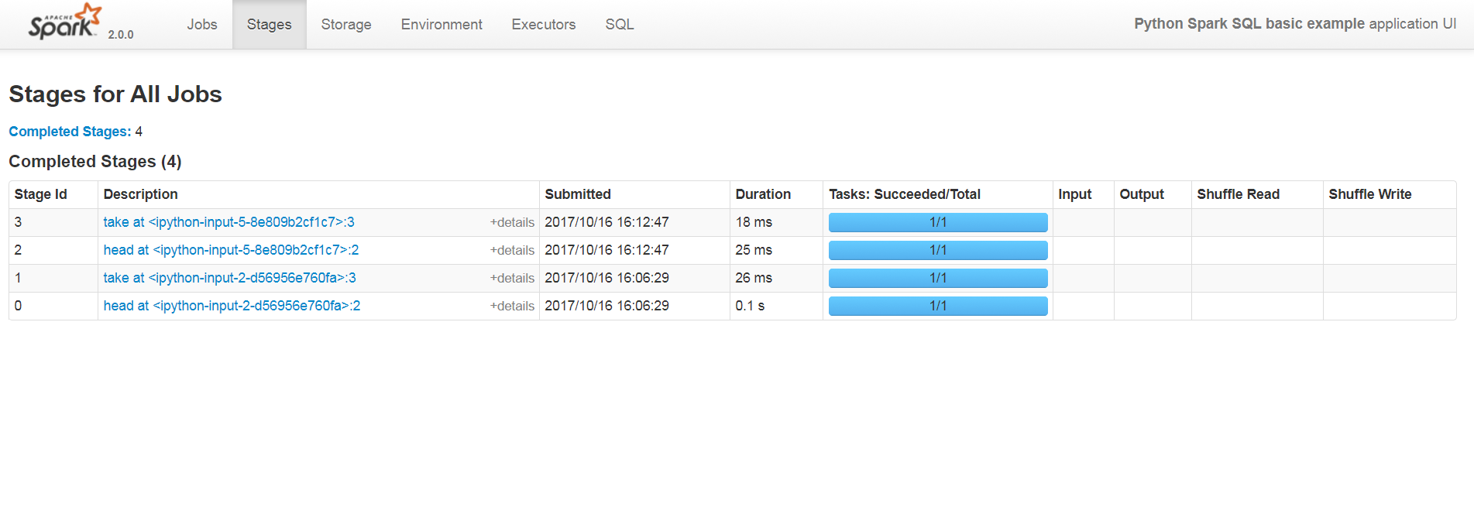
Spark UI - Stages
Notes:
The Stages tab allows for a user to take a look at the individual stages that make up a job. This tab is useful in debugging an application. Drilling into the stages takes the user to the Stage Detail tab.

Slide 28
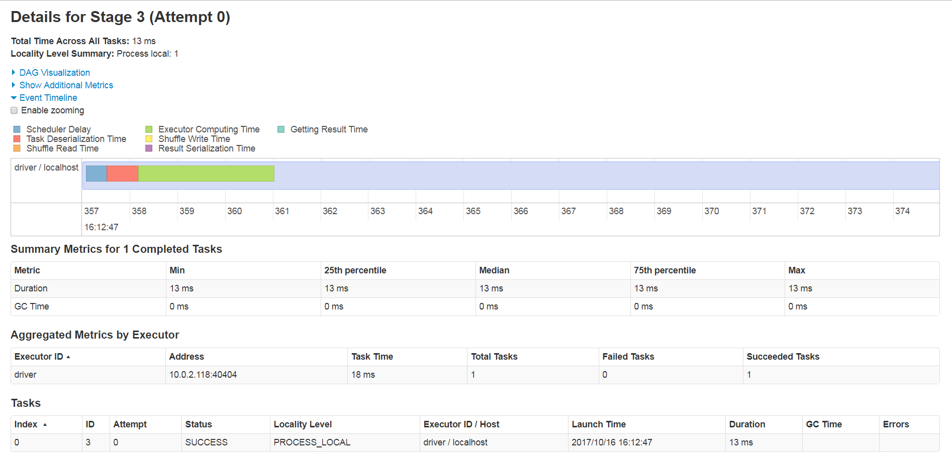
Spark UI – Stage Detail
Notes:
The Stage Detail tab presents the user with some detailed information about the implementation details behind the stage execution. The tab shows the user the DAG visualization, Event timeline (shown), Summary Metrics, Aggregated Metrics, and Task information. This information may be useful when looking for performance optimizations for a particular stage.

Slide 29
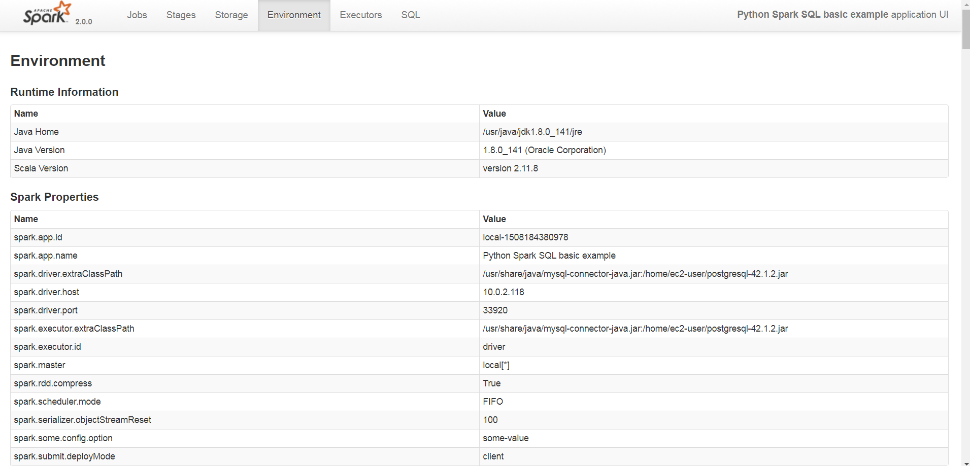
Spark UI - Environment
Notes:
The Environment tab is used to display information about the Runtime Information of the Spark container, its properties, the properties of the surrounding system, and the Java classpath that contains the Java libraries ( or JAR files) that Spark uses to run. If there are errors because of a missing library or a library with the wrong version, this is where you would come to check.
Many of the JAR files come from the default Spark library set.

Slide 30
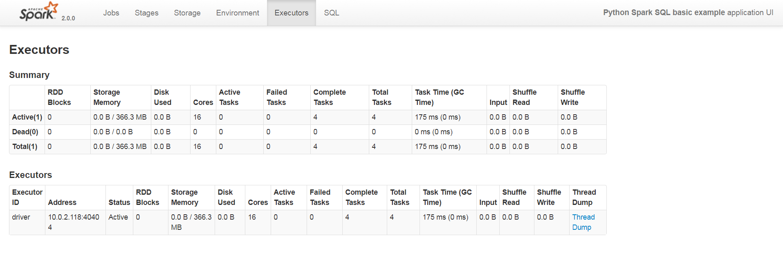
Spark UI - Stages
Notes:
The Executors tab displays information about all of the executors that make up the cluster. In this case, Spark is just using a single executor that is also the driver. Each thread that has been assigned to the cluster will show up in this list.

Slide 31
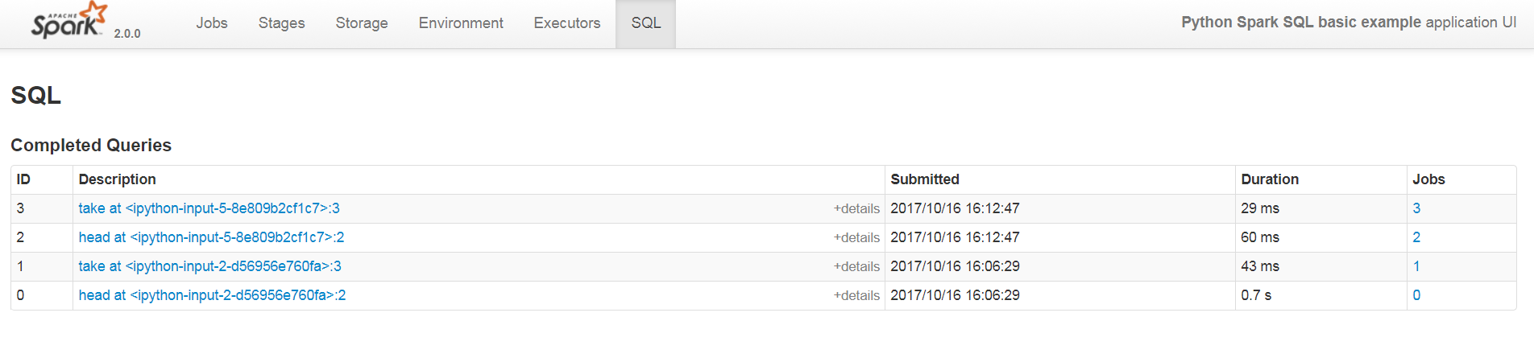
Spark UI - SQL
Notes:
The SQL tab provide additional information in terms of how the Spark has executed the SQL commands. In particular, you may notice that the SQL commands are no specifically called out on this screen, but the commands are referenced by the action that caused the commands to execute. Clicking on the action will bring up the SQL Detail screen.

Slide 32
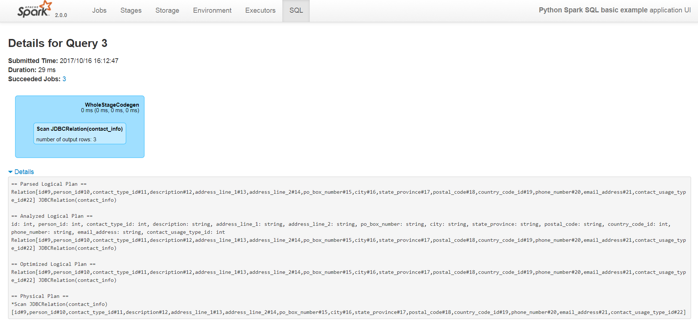
Spark UI – SQL Detail
Notes:
The SQL Detail screen has two primary pieces of information. There is the codegen area which calls out how the code was put together. There is also a detail link that reveals the execution plans for the query. This is obviously a simple query that was executed.
There are additional tabs that reveal themselves when other modules are utilized. When we use those other modules, we’ll show the new tabs available in the Spark UI site.

Slide 33
Exercise 4: Tour of the Spark UI
Load your instance of the Spark UI.
On the Jobs tab, click on one of the jobs from the last exercise.
Using this screen determine how long the first stage from the last exercise took to complete.
Go to the Environment tab.
Identify which database drivers are loaded outside of the Spark libraries.
Notes:
The goal of this exercise is familiarize yourself with the Spark UI website. It will be useful in debugging your applications and monitoring their progress.

Slide 34
Making a Spark Table
There are two ways to register your dataframe as a table in the Spark SQL Context.
df.createGlobalTempView(“VIEW_NAME”)
df.createOrReplaceTempView(“TEMP_TABLE”)
Notes:
Creating a global view or registering a temp table allows the user to later execute queries against the entity as if it were a database table. Spark uses the schema, storage format, and how it is being used to optimize the retrieval and access of the data.
Global temporary views were introduced in Spark 2.1.0 in order to share data among different sessions. The global temporary view’s lifetime is session-scoped and is dropped when the session ends. Temp tables are also session-scoped, but they are only valid for the session in question.

Slide 35
Load Data into a data frame via query
Once the data is loaded into a temporary table, it can be accessed using SQL commands, like this:
result = mySQLContext.sql(“Select p.id, c.email from Person p, Contact_Info c where p.id = c.person_id and e.contact_type = 4”)
The result of the query is also a data frame.
Notes:
Using SQL commands allows users that are most comfortable using SQL to access the power of Spark. Additionally, Spark is able to use the conditions in the command to optimize the manner in which it runs the query.

Slide 36
Exercise 5: Querying against a Registered Table
From the Jupyter notebook home, Click on the Exercise5.ipynb
Follow the prompts to load data from the table and perform simple selects and joins using the Spark SQL sql command.
Notes:
The goal of this exercise is to load data into Spark using a query against a registered temporary table. This exercise highlights that simple select statements work in the manner that someone familiar with SQL would expect.

Slide 37
Spark Data Sources
Cassandra
Couchbase
ElasticSearch
Apache HIVE
MongoDB
Neo4j
Oracle
Redis
Riak Time Series
SQL Databases via JDBC
Amazon Redshift
Amazon S3 with Apache Spark
Azure storage services
Reading Avro Files
Reading CSV Files
Reading JSON Files
Reading LIBSVM Files
Reading LZO Compressed Files
Reading ORC Files
Reading Parquet Files
Reading Text Files
Zip Files
Notes:
Alternately, Spark can create a table from a side set of available data sources. For Text, CSV, JSON, JDBC, PARQUET, ORC, HIVE and LIBSVM, there is a constant that can be used to refer to the type of data source. For other types of data sources, the fully qualified data source class name is used to specify the type.

Slide 38
Create Table
CREATE [TEMPORARY] TABLE [IF NOT EXISTS] [db_name.]table_name
[(col_name1 col_type1 [COMMENT col_comment1], ...)]
USING datasource
[OPTIONS (key1=val1, key2=val2, ...)]
[PARTITIONED BY (col_name1, col_name2, ...)]
[CLUSTERED BY (col_name3, col_name4, ...) INTO num_buckets BUCKETS]
[LOCATION path]
[COMMENT table_comment]
[TBLPROPERTIES (key1=val1, key2=val2, ...)]
[AS select_statement]
CREATE TABLE IF NOT EXISTS PERSON_TRANSACTIONS
( id INT,
person_id INT,
description TEXT,
amount DECIMAL,
transactionDate DATETIME
)
USING CSV
LOCATION ‘person_transactions.csv’;
Notes:
There is a lot embedded in this create table script. The simplest use is to create a vanilla table. The next simplest use is to create a table that refers to a text file. The example of a create table script above implements this option. Additionally the create table script can connect to remote databases using the different types of datasource available and specifying the connection information in the OPTIONS element. Further, the table can be created with a different partitioning and clustering scheme depending on what would give the best performance. Finally, there is the option to create the table based on a query using the Create Table as Select functionality.

Slide 39
Exercise 6: Working with Text based data
From the Jupyter notebook home, Click on the Exercise6.ipynb
Follow the prompts to create a table from the transactions.txt file and join it against the users table from MySQL.
Notes:
The goal of this exercise is to create a table from a text file and join it against the tables that were created from the MySQL database.

Slide 40
Multiple Databases
SPARK
SQL
MYSQL
Application
Postgres
Application
TEXT
Notes:
A Data Lake is a data environment where disparate types of data can be stored in their raw form until needed. One of the promises of the data lake was to make it easy to combine data without the boundaries that are enforced when trying to combine data stored in different databases. Even when the databases are of the same type, joining data across the databases, or federating the data, is an immense challenge.
One of the strengths of the Spark SQL framework is the ability to federate data from different data sources, while still letting the data reside in its source system. Once the data has left its source system, Spark does not care where it started. The framework takes care of storing it in a form that makes joining the data easy.

Slide 41
Exercise 7: Query From Postgres and MySQL
From the Jupyter notebook home, Click on the Exercise7.ipynb
Follow the prompts to create ContactInfo table hosted in Postgres and join it with the user table in MySQL.
Notes:
The goal of this exercise is to load data from both MySQL and Postgres and join them together in a single query.

Slide 42
Spark Core Development
Let’s say that you start with a text file whose format doesn’t match what you need. How do you convert it from lines of text into useful records?
textArrayRdd = csvRdd.map(lambda x: x.split(“,”))
def convertArrayToRecord(ta) :
#Enrich the data.
#Correct types
r
recordRdd = textArrayRdd.map(convertArrayToRecord)
Notes:
One of the first tasks in any data analysis is to take the data and get it into the right format for consumption. Spark Core offers the ability to process your data at scale. But Spark only really provides the scaling mechanism. You need to supply the business logic in the form of the map functions, filter functions, and flow of how the data is transformed from its raw form into a workable form for analysis.
In the above example, the data starts with data loaded into a CSV format. Then the data is passed into a function that enriches the data and gets it into the correct types. If you remember from earlier, if this was the only code in the flow, nothing would happen. Why not?
The transformation at hand is a map function. During a map operation, the function passed into the map is applied to each and every value of the RDD. The resulting RDD should have the same number of elements, the same cardinality. If the cardinality of the RDD changes, the map operation will present problems to downstream functions, particularly if some of those values become null or None. It is expected that the data may change types during a map operation. For example above the record comes from a CSV which does not have the idea of a number as different from other text. So we would need to convert the numerical fields from text to be able to use them.
Nothing would happen because the flow described above does not contain an action to force Spark to initiate the computation.

Slide 43
Spark Transformations
Transformation | Meaning
filter(f) | Return a new RDD containing only the elements that satisfy a predicate.
flatMap(f, preservesPartitioning=False) | Return a new RDD by first applying a function to all elements of this RDD, and then flattening the results
mapPartitions(f, preservesPartitioning=False) | Return a new RDD by applying a function to each partition of this RDD
mapPartitionsWithIndex(f, preservesPartitioning=False) | Return a new RDD by applying a function to each partition of this RDD, while tracking the index of the original partition.
sample(withReplacement, fraction, seed=None) | Return a sampled subset of this RDD.
union(other) | Return the union of this RDD and another one.
intersection(other) | Return the intersection of this RDD and another one. The output will not contain any duplicate elements, even if the input RDDs did
Notes:
The functions above are all common transformation functions. We already discussed map on the previous page which is probably the most common transformation. The highlighted selections on the next several pages are other common transformations and actions.
Filter is a common way to take a set of data and subset the items. The filter function takes in the type of the RDD and applies a condition that returns true or false. Items that evaluate as true are persisted in the RDD returned.
FlatMap is a form of map operation where the cardinality of the objects can change. Either a single item can become an entire list of new objects or an item may be omitted from the RDD. Filter can be seen as a special case of FlatMap.
Sample is used to scale down the scope of the RDD into something manageable. Random sampling is a technique to reduce a Big Data set down to something where small data techniques can be used to get a sense of the data.
Union is used to combine two similar RDDs. This is used frequently in stream processing where the data streams from different but related sources need to be combined for analysis.

Slide 44
Spark Transformations
Transformation | Meaning
pipe(command, env=None, checkCode=False) | Return an RDD created by piping elements to a forked external process.
coalesce(numPartitions, shuffle=False) | Return a new RDD that is reduced into numPartitions partitions
repartition(numPartitions) | Return a new RDD that has exactly numPartitions partitions.
repartitionAndSortWithinPartitions(numPartitions=None, partitionFunc=f, ascending=True, keyfunc=g) | Repartition the RDD according to the given partitioner and, within each resulting partition, sort records by their keys.
join(other, numPartitions=None) | Return an RDD containing all pairs of elements with matching keys inself and other. Each pair of elements will be returned as a (k, (v1, v2)) tuple, where (k, v1) is in self and (k, v2) is in other. Performs a hash join across the cluster.
cogroup(other, numPartitions=None) | For each key k in self or other, return a resulting RDD that contains a tuple with the list of values for that key in self as well as other.
Notes:
Here are some more common transformations.
Coalesce and Repartition are almost the same operation with two significant differences. First Coalesce requires that the number of partitions is smaller than the previous number of partitions; Repartition accepts both larger and smaller values for the new number of partitions. Second, coalesce doesn’t automatically trigger a shuffle operation where data from different machines is intermingled; Repartition does.
Join is a RDD equivalent of the SQL operation. In this case, the two data sets are joined based on common keys. Rows without matches are removed from the result. The resulting structure is returned as a tuple of key, and a sequence consisting of the value from the first match and the value from the second match. There are also method for fullOuterJoin, leftOuterJoin, and rightOuterJoin.

Slide 45
Spark Transformations
Transformation | Meaning
groupByKey(numPartitions=None, partitionFunc=f) | Group the values for each key in the RDD into a single sequence. Hash-partitions the resulting RDD with numPartitions partitions. Note: If you are grouping in order to perform an aggregation (such as a sum or average) over each key, using reduceByKey or aggregateByKey will provide much better performance.
reduceByKey(func, numPartitions=None, partitionFunc=f) | Merge the values for each key using an associative and commutative reduce function. This will also perform the merging locally on each mapper before sending results to a reducer, similarly to a “combiner” in MapReduce. Output will be partitioned with numPartitions partitions, or the default parallelism level if numPartitions is not specified. Default partitioner is hash-partition.
aggregateByKey(zeroValue, seqFunc, combFunc, numPartitions=None, partitionFunc=p) | Aggregate the values of each key, using given combine functions and a neutral “zero value”. This function can return a different result type, U, than the type of the values in this RDD, V. Thus, we need one operation for merging a V into a U and one operation for merging two U’s, The former operation is used for merging values within a partition, and the latter is used for merging values between partitions. To avoid memory allocation, both of these functions are allowed to modify and return their first argument instead of creating a new U.
sortByKey(ascending=True, numPartitions=None, keyfunc=f) | Sorts this RDD, which is assumed to consist of (key, value) pairs.
Notes:
Here is a sampling of operations that use the paired structure of the contained tuples to gather related data. ReduceByKey is highlighted. ReduceBy Key takes all of the values for each key and combined them all according to the function provided. An example of a reduceByKey function would be aggregating the sales by customer.

Slide 46
Spark Actions
Action | Meaning
reduce(f) | Reduces the elements of this RDD using the specified commutative and associative binary operator. Currently reduces partitions locally.
collect() | Return a list that contains all of the elements in this RDD. Note that this method should only be used if the resulting array is expected to be small, as all the data is loaded into the driver’s memory.
count() | Return the number of elements in this RDD.
first() | Return the first element in this RDD
take(num) | Take the first num elements of the RDD. It works by first scanning one partition, and use the results from that partition to estimate the number of additional partitions needed to satisfy the limit.
takeSample(withReplacement, num, seed=None) | Return a fixed-size sampled subset of this RDD.
takeOrdered(num, key=None) | Get the N elements from a RDD ordered in ascending order or as specified by the optional key function.
Notes:
Here is a list of Spark actions. Again common actions are highlighted. The role of the action is to force the Spark framework to evaluate the transformations on the RDD.
Reduce combines all of the elements of the RDD into a single value. Examples of a reduce function include aggregating the overall sales into a single number or merging the values of the RDD into a collection.
Count returns the number of elements in the RDD.
First is a way to look at the first elements of the RDD. It can be used to get a sense of the layout of the variables in the RDD. It is different from take(1) in that it does not assume that all of the data can fit onto a single machine. Collect has the same problems of take in that it merges all of the data onto a single machine. If there is too much data, the machine can run out of memory or the process will demonstrate significant slowdowns.

Slide 47
Spark Actions
Action | Meaning
saveAsSequenceFile(path, compressionCodecClass=None) | Output a Python RDD of key-value pairs (of form RDD[(K, V)]) to any Hadoop file system, using the org.apache.hadoop.io.Writable types that we convert from the RDD’s key and value types.
saveAsPickleFile(path, batchSize=10) | Save this RDD as a SequenceFile of serialized objects. The serializer used is pyspark.serializers.PickleSerializer, default batch size is 10.
saveAsTextFile(path, compressionCodecClass=None) | Save this RDD as a text file, using string representations of elements.
countByKey() | Count the number of elements for each key, and return the result to the master as a dictionary.
foreach(f) | Applies a function to all elements of this RDD.
Notes:
Saving the RDD to a text file or a pickle file is one way to save progress or deliver value to the organization. There are a number of different ways to save the data from your Spark jobs, especially when you are working in Spark SQL. But these are some of the ways native to Spark SQL.
SaveAsTextFile saves the data to the data store in a text format. Text form is useful for human readers, but is generally inefficient in terms of storage. The compression codec allows the developer to specify how the data will be compressed on the file system to gain some measure of efficiency in storage.
Foreach is a way to handle storage mechanisms that are have not been developed by the community. ForEach is different among the actions in that it does not return any values from it. In the past I’ve used foreach blocks to write data to HBase or create messages to write to a Kafka queue.

Slide 48
Exercise 8: Working with Application Generated Data
From the Jupyter notebook home, Click on the Exercise8.ipynb
Follow the prompts to load and analyze the hr.csv file using Spark Core functions.
Notes:
The goal of this exercise is to create a table from application generated data and save the data to a permanent store.

Slide 49
Optimization: Push down to the database
You can pushdown an entire query to the database and just return the result of the query. (Note: The parantheses are necessary.)
val pushdown_query = "(select * from employees where emp_no < 10008) emp_alias"
val df = spark.read.jdbc(url=jdbcUrl, dbtable=pushdown_query, properties=connectionProperties)
display(df)
You can also prune columns and pushdown predicates to the database with DataFrame methods.
spark.read.jdbc(jdbcUrl, "diamonds_mysql", connectionProperties) \
.select("carat", "cut", "price") \
.where("cut = 'Good'")
Notes:
There are some things that are best done on the source database. One of those things is filtering data. In part it is because the database does that efficiently, but mostly because the data is not needed to be serialized, physically sent over the wire, deserialized, and then filtered away. The first option allows for you to push an arbitrary query to the database to be executed there and the results returned. The second option is limiting the returns from a single table by filtering the columns and applying a where condition.

Slide 50
Exercise 9: Working with Pushdown Predicates
From the Jupyter notebook home, Click on the Exercise9.ipynb
Follow the prompts to load the data from the USER_LOGS table. You’ll run the query using a couple of different techniques to minimize the data returned.
Notes:
The goal of this exercise is to practice pushing down predicates to the database.

Slide 51
User Defined Functions
User defined functions enable the developer to insert arbitrary logic into a query. The function is registered with the SQLContext object by calling:
import re
def clean ( str ) :
"Removes bad words from a string"
p = re.compile('d.mn|f.ck|sh.t|frack|b.tch')
p.sub(str, '****', count=0)
str
sqlContext.udf.register("clean", clean)
sqlContext.sql("select clean(comments) from user_comments;")
Notes:
User defined functions, or UDFs, are used to transform values from a single row within a table to produce a single output value per row. The UDF logic should be as slim as possible. The function is defined in the pyspark shell and registered with the SQLContext using the register function call. The function can then be used in the SQL commands issued within the SQL Context. If your code requires python libraries, you will want to make sure that those libraries are present on each of the nodes processing your query.
There are important performance considerations to consider when using Python UDFs. The UDF will be invoked for each row and each invocation will require the data to be serialized between the executor JVM and the Python interpreter running the UDF logic. Arbitrary UDF logic is also not easily understood by the Spark Catalyst optimizer. If you need to stay within the Python language, there isn’t much that can be done. But if you can implement the UDF in Scala or Java, the additional serialization can be avoided. There are also a set of Hive UDFs that can be invoked from Python that will also be more efficient. But the most efficient will be using the Spark query functions if at all possible.

Slide 52
Exercise 10: Creating a User Defined Function
From the Jupyter notebook home, Click on the Exercise10.ipynb
Follow the prompts to create a phone number formatter function. Execute the phone number formatter function against the USER_CONTACT_INFO table to standardize the formatting of the phone numbers.
Notes:
The goal of this exercise is to develop and use a custom user defined function.

Slide 53

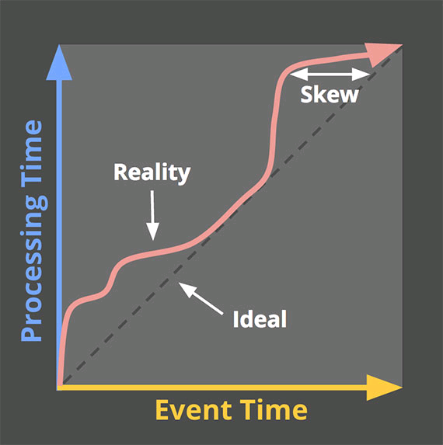
Streaming concepts
Stream – continuously updating data set
Time
Event time – when an event actually occurred
Processing time – when the event record happens to be processed by the streaming solution
Ingestion time – when the event record is loaded into the streaming solution
Skew – the difference between event time and processing time
Notes:
We’re going to start talking about stream processing. To do this we’ll need to get down some terminology.
A stream is a continuously updating data set. Because a stream does not necessarily have a known end, the application must treat this as an infinitely sized data source. Many batch processing concepts break down when your data set doesn’t end.
One common way to segment your stream is to break it down in time. But you work to break down the stream into time segments, you need to be aware that there are several different timestamps in the lifecycle of an event. First, there is the time when the event actually happened – the event time. But there was likely a delay between the event happening and it arriving in our stream to process it. The time when it arrives in the stream is the ingestion time. Finally the event may not be processed immediately on ingestion depending on the volume of other data in the queue. When the application finally gets around to processing the data is the processing time. The difference between the event time and the processing time is called the skew.
A story may help illustrate the different timestamps. My brother hit me (event time). I went and told on him to my mother (ingestion time). She finished what she was doing at the stove and went to find my brother (processing time). The rest of the story is all about the duration of the processing and wooden spoons.

Slide 54
Time Windows and Data
Notes:
There are several different ways to divide up the stream into processing windows. In general they are depend on the time width of the window and the slide duration. The first is called hopping window where the slide duration is less than the window width. The second is called a tumbling window where the slide duration equals the window width. The sliding window has a fixed width by continuously moves forward. One important difference between these two types of windows is that events are assigned to one and only one tumbling window, but an event can be assigned to multiple hopping or sliding windows. For these types of windows, Spark requires that the time width and sliding duration be multiples of the processing duration.
The last method has a variable time width and slide duration. It establishes windows only for intervals where there is data to be collected. This technique is called session windows.

Slide 55
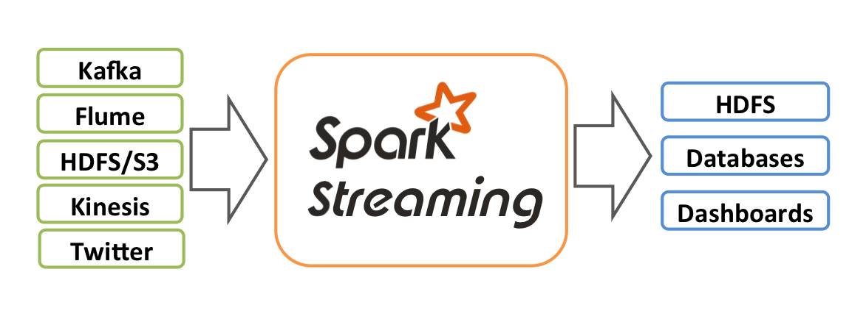
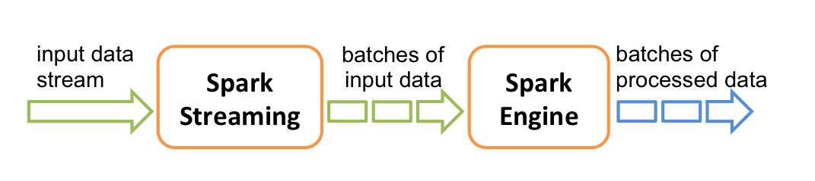
Spark Streaming
Notes:
The top picture describes how Spark Streaming looks from the outside. Data is produced in some sort streaming solution whether that is Kafka topics, Flume sinks, HDFS/S3 directories, Kinesis topics, or Twitter firehoses. Spark Streaming ingests the data and updates HDFS, Databases, or Dashboards with the processed data. Looking closer, Spark Streaming is taking the flow of data and chopping it into small batches, or micro-batches. The micro-batches are then ingested by the Spark Engine which emits micro-batches of processed data that updates the directory structures, database tables, or dashboard displays. This unending collection of micro-batches is called a Distributed Stream or DStream.
The micro-batch architecture is a major differentiator in how Spark Streaming processes data. Other frameworks like Apache Storm and Apache Samza developed a message at a time processing framework. But Spark was able to leverage its other investments in its Batch processing framework to extend its ability to process the data.

Slide 56
Spark Streaming Development
from pyspark import SparkContext
from pyspark.streaming import StreamingContext
sc = SparkContext(“APP_MASTER", “APP_NAME")
ssc = StreamingContext(sc, DURATION)
## DO STUFF
ssc.start()
ssc.awaitTermination()
# LATER
ssc.stop()
Notes:
Each Spark Streaming application has some of the same boilerplate code. At the start of the application, the SparkContext and the StreamingContext are initialized. Next the developer defines the application flow that tells how Spark obtains the streaming data and how it is going to perform the data processing. Finally the StreamingContext is started and the await termination commands is entered. Once the StreamingContext is started, the application starts ingesting and processing the data. It is important not to reverse the order of these commands. Later the application is either stopped or a stop command is issued from the StreamingContext.
The important variables to note are the APP_MASTER, APP_NAME, and DURATION. The APP_MASTER determines where the machine will deploy its code. This can either be on a cluster (Hadoop/Mesos) or locally. If you want to run locally, you can specify “local[N]” where N is the number of threads that you want to use on the local machine. The number of threads shouldn’t be greater than the number of cores on your machine. APP_NAME is the name of your application. It should be unique for your application. In this class, we’ll use your username.
The final parameter is the DURATION. This specifies the duration of the processing window of your Spark Streaming application. If specify a processing window duration of 60 seconds, Spark will collect from its stream sources all of the messages available in sixty seconds and then send them to be processed by the application. If more messages come into the framework that can be processed in processing window, the application will start backing up. Tuning the processing window based on the flow of messages is a skill that developers need to develop.

Slide 57
Spark Streaming Development
from pyspark.streaming.kafka import KafkaUtils
kafkaStream = KafkaUtils.createStream(ssc, “ZOOKEEPER_URL", “CONSUMER_GROUP", {“QUEUE_NAME":PARTITION_NUMBER})
Notes:
The first step in defining your processing workflow is to get data streaming into your application. The above code is used to ingest streaming data from Apache Kafka. The important parameters in this definition are ZOOKEEPER_URL, CONSUMER_GROUP, QUEUE_NAME, and PARTITION_NUMBER. The ZOOKEPER_URL defines the location of the Zookeeper instance that is assisting Kafka with handling processing on the topics. The CONSUMER_GROUP specifies which application is consuming the data. In this class, we’ll use your username for the consumer group name. The QUEUE_NAME is the queue that your application is consuming from and the PARTITION_NUMBER is the number of partitions for that queue.
Stream sources defined by the community generally handle backpressure. Backpressure is a signal from the processing application that it needs to receive less because it is currently unable to keep up. This is important to minimize the number of messages waiting in the application itself in order to be processed to save on memory consumption.
It is possible to create your own stream source, but I’d advise checking out what has been produced by the community to see if there is already a source that has been created.

Slide 58
Spark Streaming Development
Method | Description
map(f, preservesPartitioning=False) | Return a new DStream by applying a function to each element of DStream.
flatMap(f, preservesPartitioning=False) | Return a new DStream by applying a function to all elements of this DStream, and then flattening the results
filter(f) | Return a new DStream containing only the elements that satisfy predicate.
cache() | Persist the RDDs of this DStream with the default storage level
count() | Return a new DStream in which each RDD has a single element generated by counting each RDD of this DStream.
pprint(num=10) | Print the first num elements of each RDD generated in this DStream.
saveAsTextFiles(prefix, suffix=None) | Save each RDD in this DStream as at text file, using string representation of elements.
Notes:
Many of the same commands are available for stream processing that are available for batch processing. The major difference is that these operations work on a DStream instead of on a RDD. Here are some important differences:
Count is now an transformation instead of an action.
Pprint is available as an action.
SaveAsTextFiles saves one file per RDD or one file per processing window.

Slide 59
Spark Streaming Development
parsed = kafkaStream.map(lambda s: s[1].split("|"))
filtered = parsed.filter(lambda a: a[0] == “1”)
filtered.pprint()
Notes:
Spark Streaming like Spark Core before it depends on creating a workflow of transformations and actions. In the above example, a pipe-delimited record is ingested from the stream source and broken into a sequence of strings. Then the stream is filtered so that only the records with “1” in the first position are part of the set that is printed out in the third line. Without the third line, Spark would not evaluate the first two lines because no action was called.

Slide 60
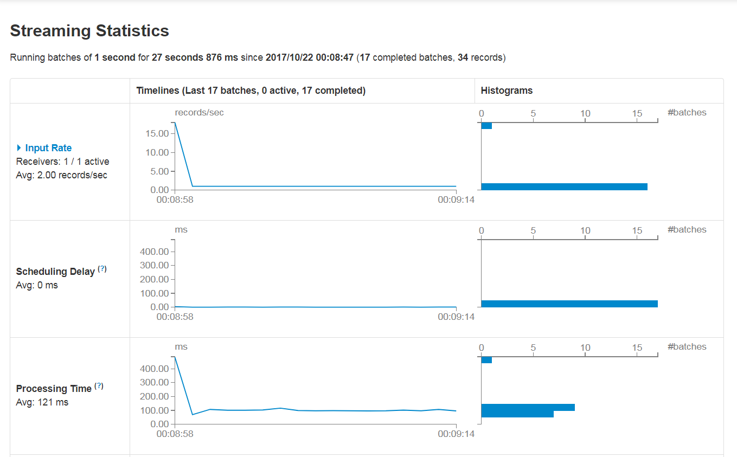
Spark UI – Spark Streaming
Notes:
When Spark streaming is processing, you can go back to the Spark UI and a streaming tab will be available. When you select the steaming tab, you’ll be presented with a screen that looks similar to this one. The top line tells you how long your process has been running, what its processing window duration is, and when it was started. Here the processing window is one second wide and has been running for 27 seconds.
The first section shows the input rate which is how many records are being ingested per second. The average records per second is detailed. There is a graph which details the number of records per second. In this case there were initially a number of records in the queue, but after that chunk of records was received the steady state was one record per second.
The next section show the scheduling delay. When the application is backing up because it has received more data than it can handle, the graph in this section would show some change. With a flat line here, the application is able to keep up with the processing.
The next section shows how long it takes to process a given batch of records. With an average of 121 ms against a processing duration of 1 second, the application is clearly able to keep up.

Slide 61
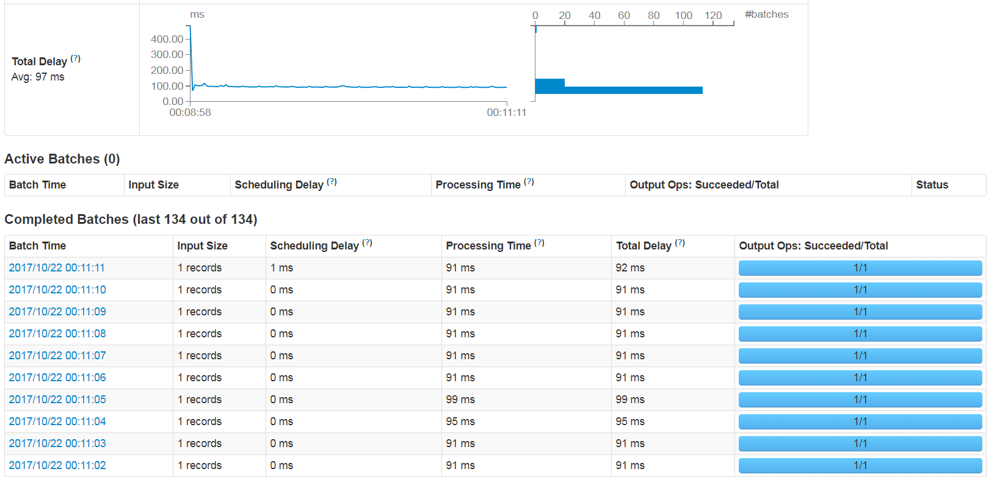
Spark UI Streaming
Notes:
The next section keeps track of the total delay. The total delay is the sum of the processing time and the scheduling delay. In this case, the processing time and the total delay would show the same information.
The next section tracks active batches. The active batches include anything that is currently being processed by this application. Generally this area will contain anything that is currently being worked on or has been ingested and is waiting to be worked on.
The last area is for completed batches. If the processing algorithm emits logs, you can use the links here to drill into the logs. This area tracks how many records are in each batch, the batch’s delays, and an indication of its status.

Slide 62
Windowing Functions
Function | Description
window(windowDuration, slideDuration=None) | Return a new DStream in which each RDD contains all the elements in seen in a sliding window of time over this DStream.
countByWindow(windowLength, slideInterval) | Return a sliding window count of elements in the stream.
reduceByWindow(reduceFunc, invReduceFunc, windowDuration, slideDuration) | Return a new DStream in which each RDD has a single element generated by reducing all elements in a sliding window over this DStream.
reduceByKeyAndWindow(func, invFunc, windowDuration, slideDuration=None, numPartitions=None, filterFunc=None) | Return a new DStream by applying incremental reduceByKey over a sliding window.
countByValueAndWindow(windowDuration, slideDuration, numPartitions=None) | Return a new DStream in which each RDD contains the count of distinct elements in RDDs in a sliding window over this DStream.
Notes:
The windowing functions give Spark Streaming the ability to work with data using windows. One popular windowing method is counting by window. Combining a count by window function with a collection of filters gives the developer the ability to return metrics on different facets of the system per time window – errors, sales, visits.

Slide 63
Windowing in Spark
transactionCountStream = transactionStream.countByWindow(30)
transactionSumStream = transactionStream.reduceByWindow(lambda x, y : x.total + y.total, 30, 10)
transactionSumByUserStream = transactionStream.reduceByKeyAndWindow(lambda x, y: x.total + y.total, 30, 10)
Notes:
Here are a couple of examples of operations that can be performed against a string of transactions. The first example is counting the transactions per thirty seconds. The second example is getting a total of all transactions per thirty seconds using a hopping window. The last example breaks the transactions down to a per user basis and sums all of the transactions per thirty seconds using a hopping window.

Slide 64
Exercise 11: Working with Streaming Data
From the Jupyter notebook home, Click on the Exercise11.ipynb
Follow the prompts to write a Spark Streaming application to ingest the data streaming into the Kafka transactions topic and analyze the data using the different windowing operations.
Notes:
The goal of this exercise is to develop an application using Spark Streaming and to see how windows can assist in streaming analysis.

Slide 65
Resources
https://github.com/myp3tr0ck/TDWIExercises

Slide 66

Join Our Team
Contact:
Your.name@daugherty.com

Slide 67
Appendix 1: Environment Set Up
I prepared the EC2 instance following this post:
https://medium.com/@josemarcialportilla/getting-spark-python-and-jupyter-notebook-running-on-amazon-ec2-dec599e1c297
In addition we had to install the MySQL JDBC Driver and the Postgres JDBC Driver.
There was also a matter of setting up the security groups to allow the users to see the Spark UI and to allow the Spark server to access the Postgress and MySQL databases.
Finally, when installing the JDBC drivers, I had to change the default Spark configuration to add the JDBC drivers to the classpath.

Slide 68
Appendix 2: Streaming Environment Setup
Install Zookeeper
Install Kafka
Download spark-streaming-kafka-0-8-assembly_2.11-2.0.0.jar
Add the jars to the spark-defaults.conf
Start Zookeeper
Start Kafka

